Slide 1
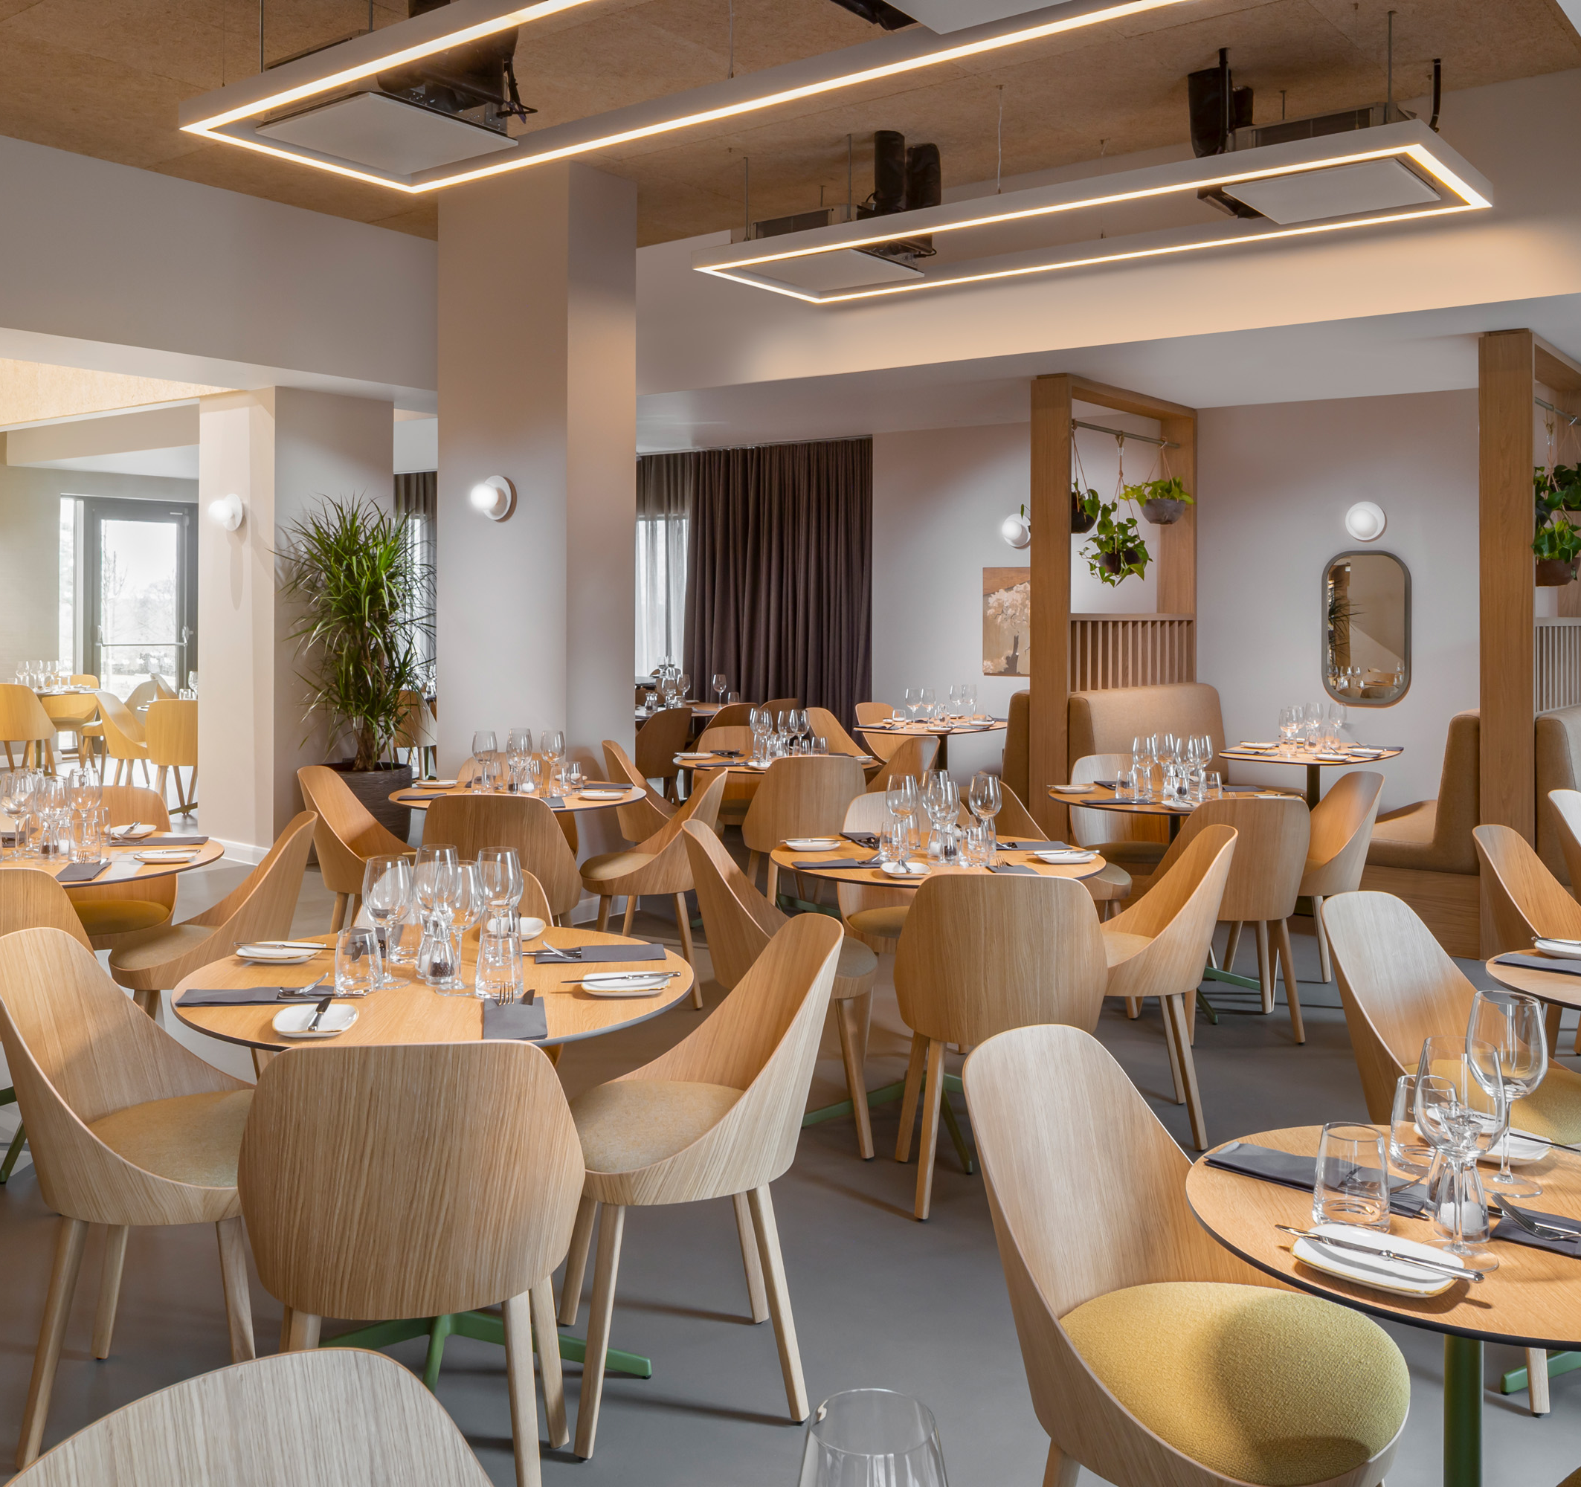
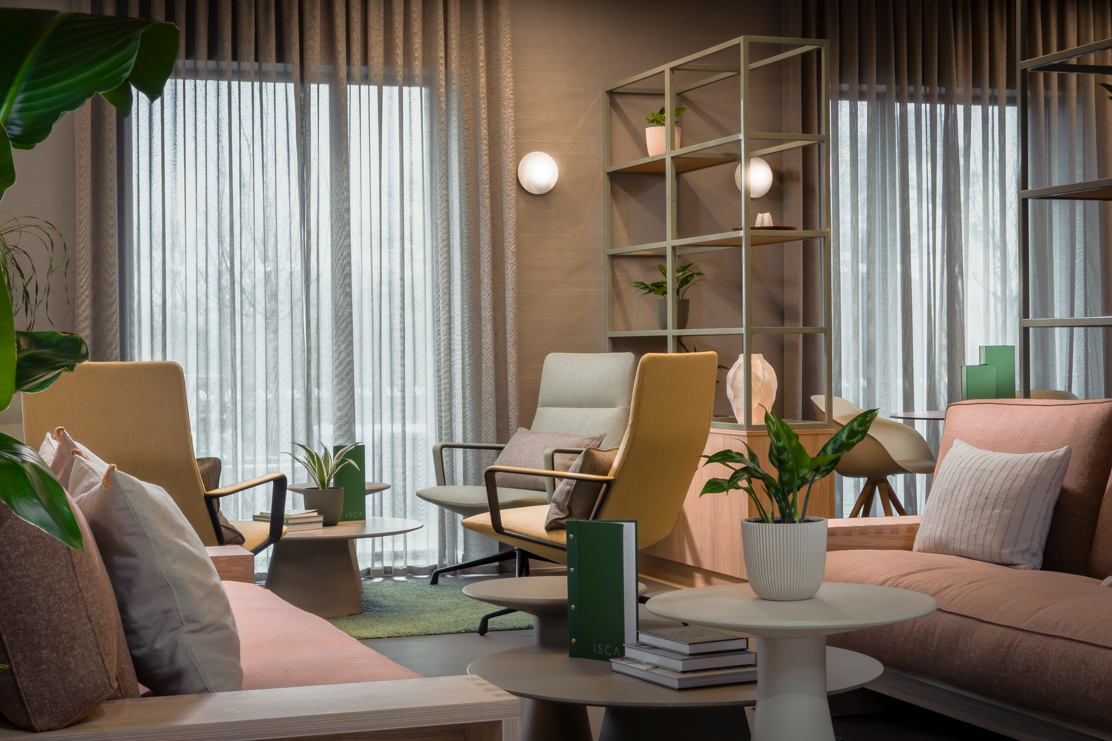
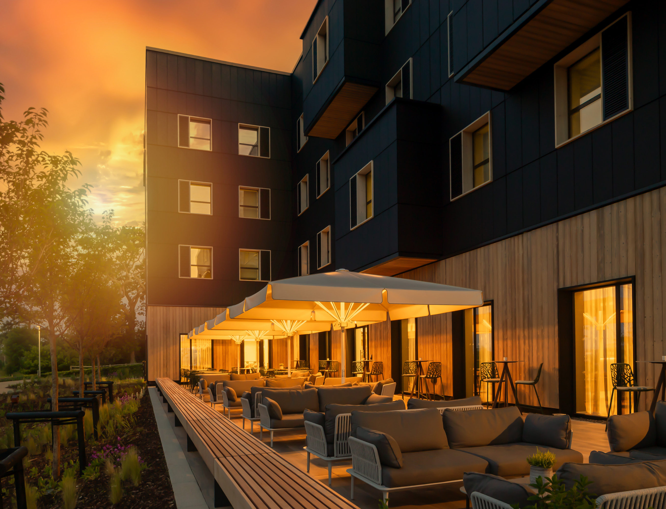

Low
Carbon
Pioneers
Case Study

Slide 2
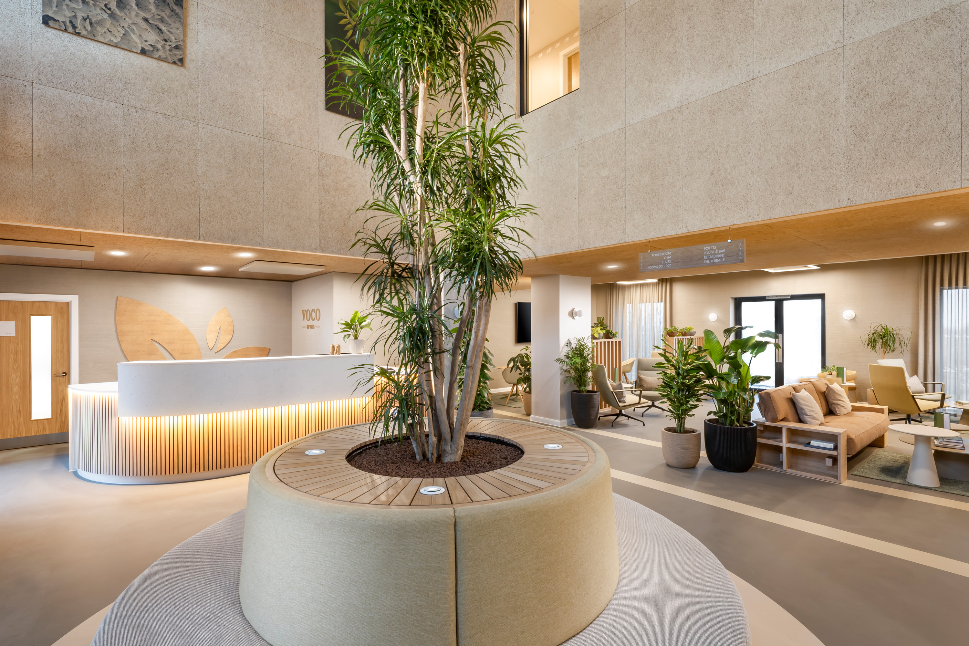
Introducing Low
Carbon Pioneers
Our Low Carbon Pioneer, voco Zeal Exeter Science Park
Low Carbon Pioneers is an initiative that celebrates
and promotes hotels that are energy efficient,
have no fossil fuels combusted onsite*,
and are backed by renewable energy.
At the voco Zeal Exeter Science Park, we are passionate about sustainable hospitality. We’re giving guests the opportunity to have a low carbon visit whilst enjoying
a relaxed and care free stay.
Our hotel is one of the most energy efficient buildings in the UK. It has no fossil fuels on-site and is backed by renewable energy. On the next page, you can see some of the measures we have put in place at our hotel…
*Except for backup generators that fall below 5% of the hotel’s total annual energy consumption

Slide 3

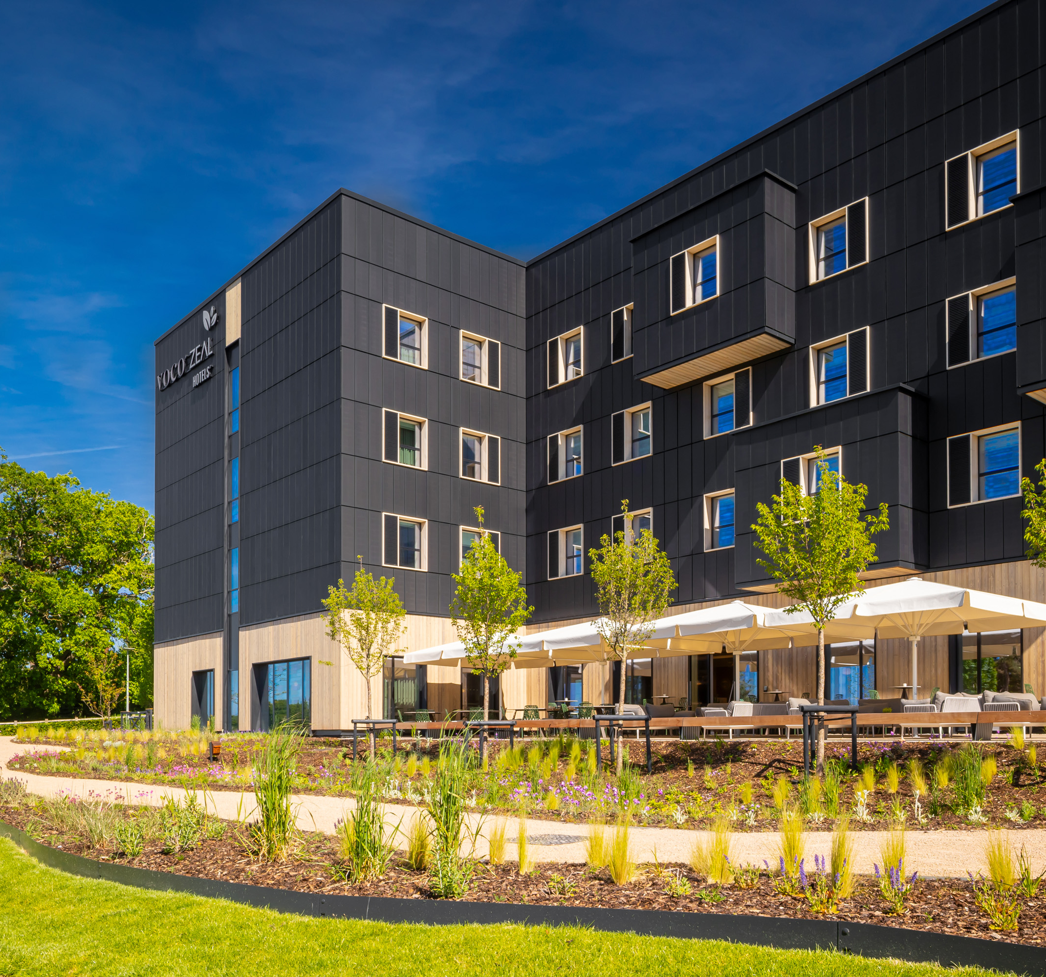
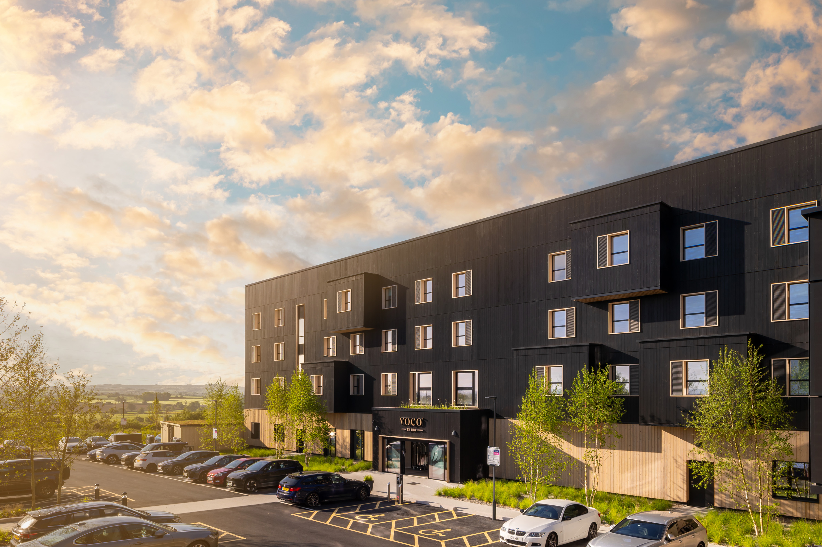
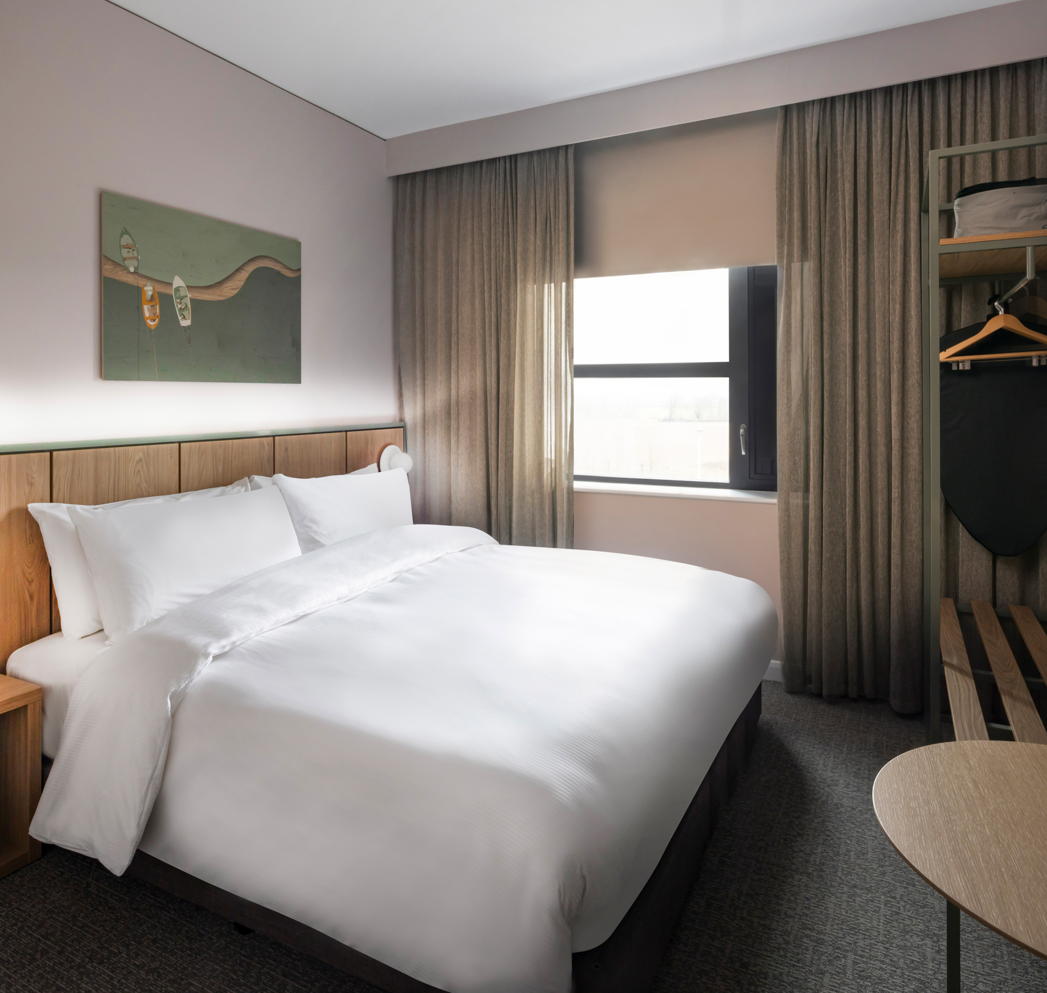
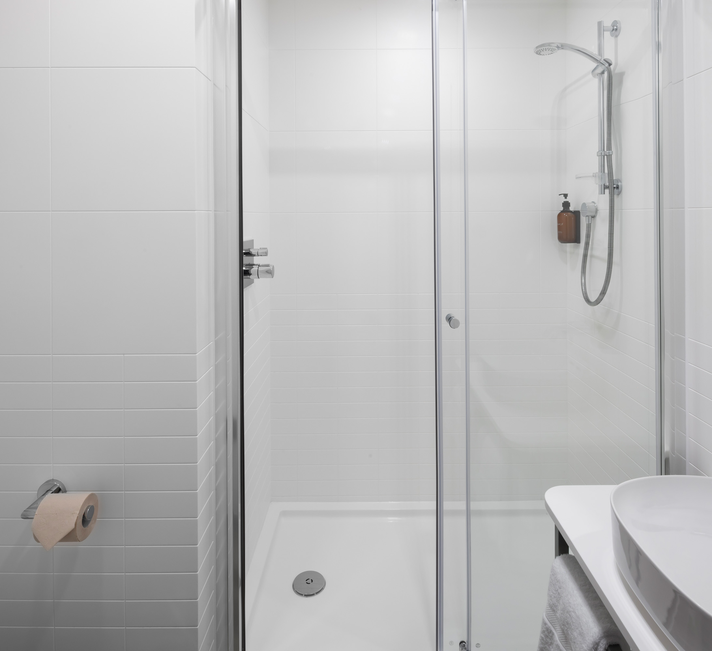
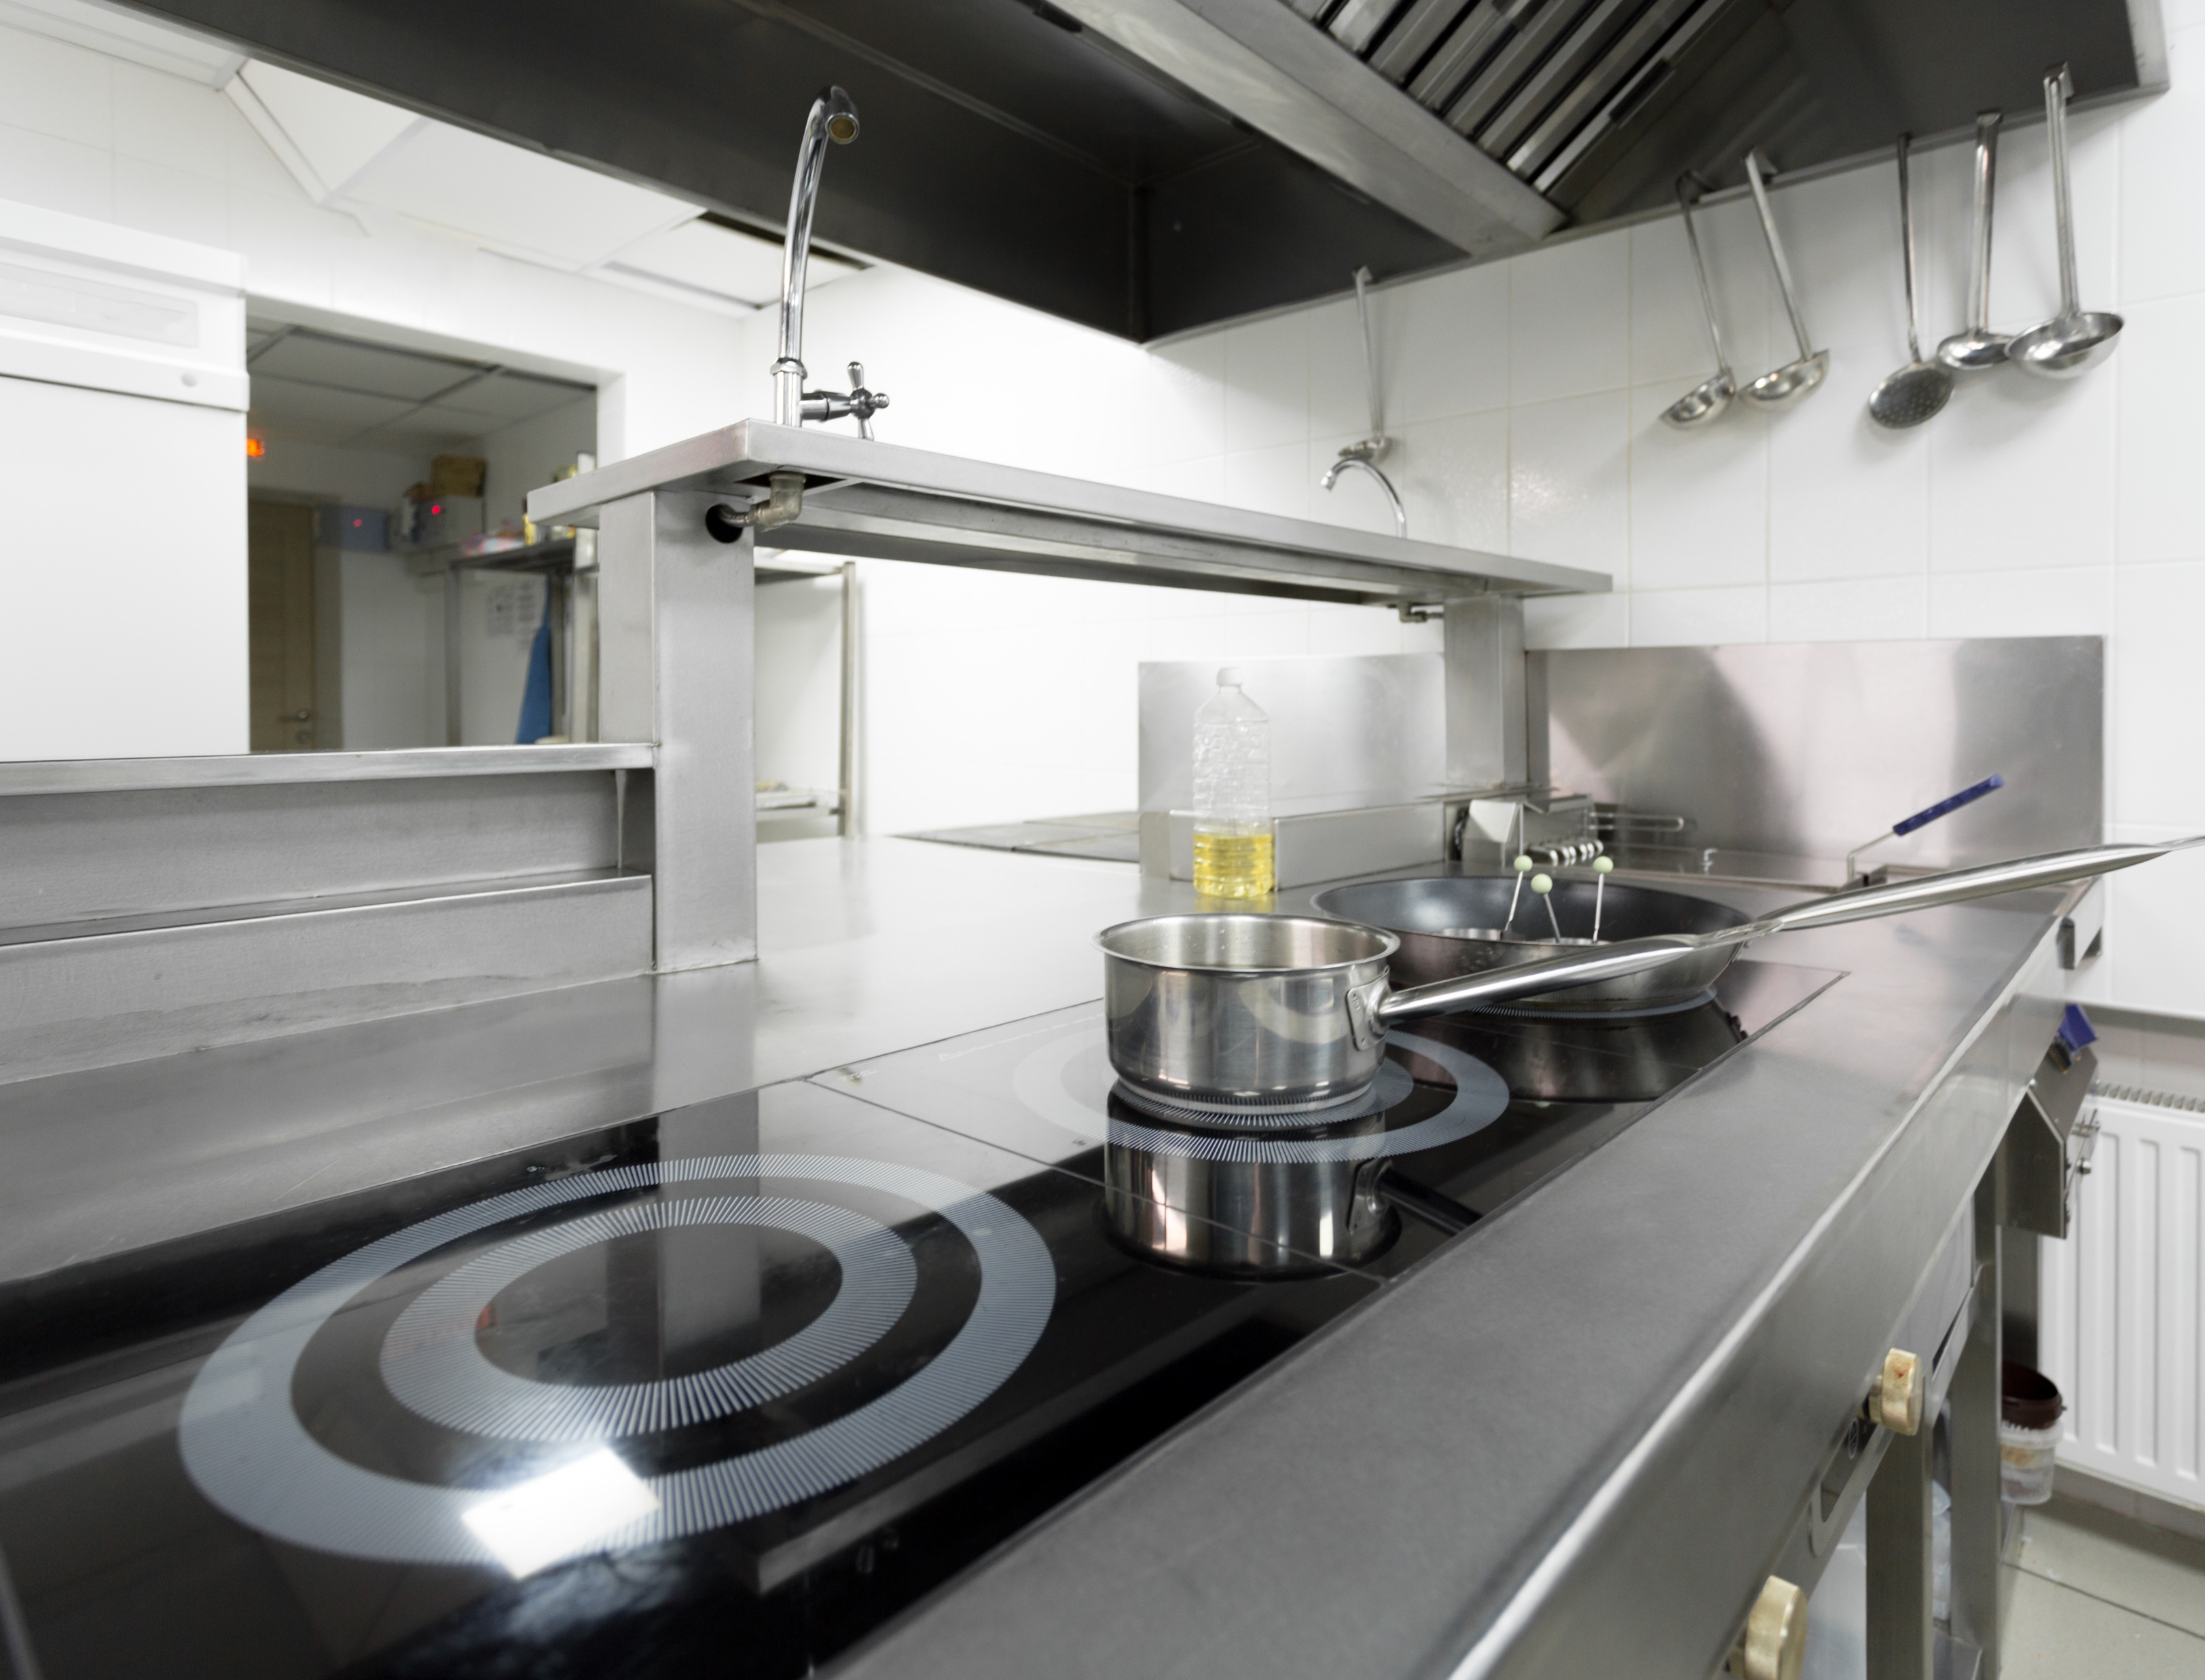

Heat recovery:
  Reducing wasted energy by recycling heating and cooling energy across
  the hotel
Lighting with occupancy sensing controls:
  Turning lights off automatically when no one is around
Low Carbon Pioneers
voco Zeal Exeter Science Park
Rooftop and solar cladding:
  Generating renewable energy which powers most of the needs of the hotel
Designed to minimise energy use:
  Designed to achieve one of the lowest energy usage intensities in the UK
Submeters to monitor and improve energy usage:
  Constantly looking for improvements to reduce energy usage across
  the hotel
Passivhaus levels of insulation:
  Reducing energy needed for heating and cooling
  across the year
Recycled concrete GGBS:
  Reducing carbon in construction
An engaged team:
  Monitoring energy consumption and putting in place energy reduction best practices
Adiabatic cooling:
  Minimising cooling energy vs traditional air conditioning systems
High efficiency showers and taps:
  Reducing energy
  and water usage
CO2 hot water heat pumps:
  Reducing the energy required to heat hot water whilst also minimising emissions from refrigerant use
All electric kitchen with induction hobs:
  Removing any fossil fuels and enabling a more efficient kitchen
We’re proud to say at our hotel we are Green Key certified

